Slide 1
Raw Text Data
Data Cleaning
Sentiment Label Standardization
Feature Extraction
Graphical Visualization
Model Training & Testing
Prediction Layer
Evaluation Metrics
Final Output

Slide 2






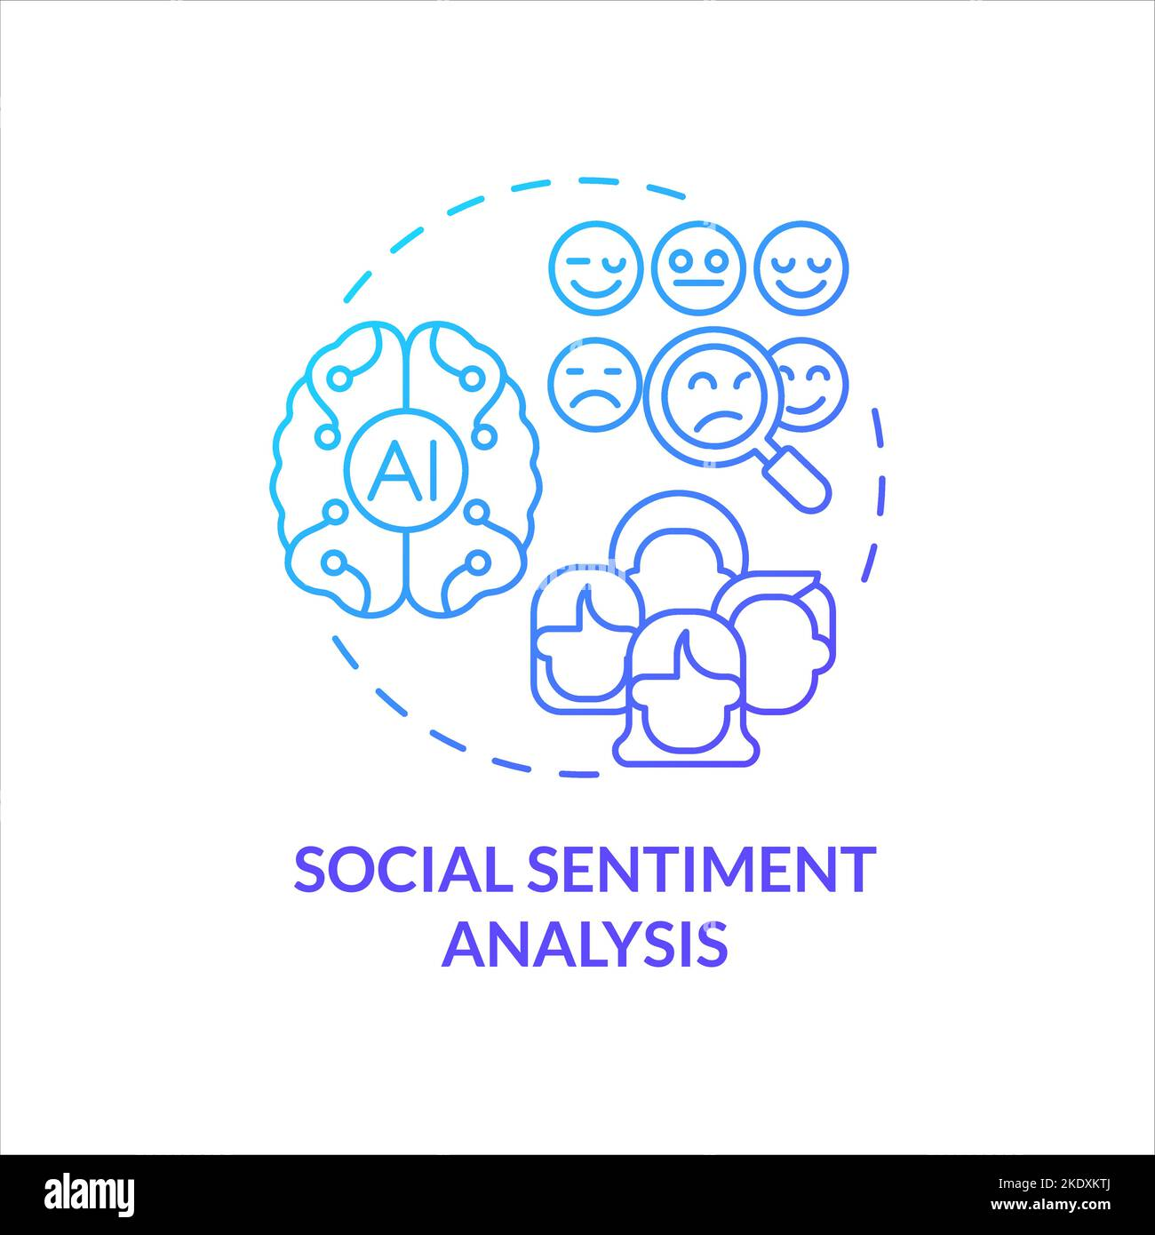


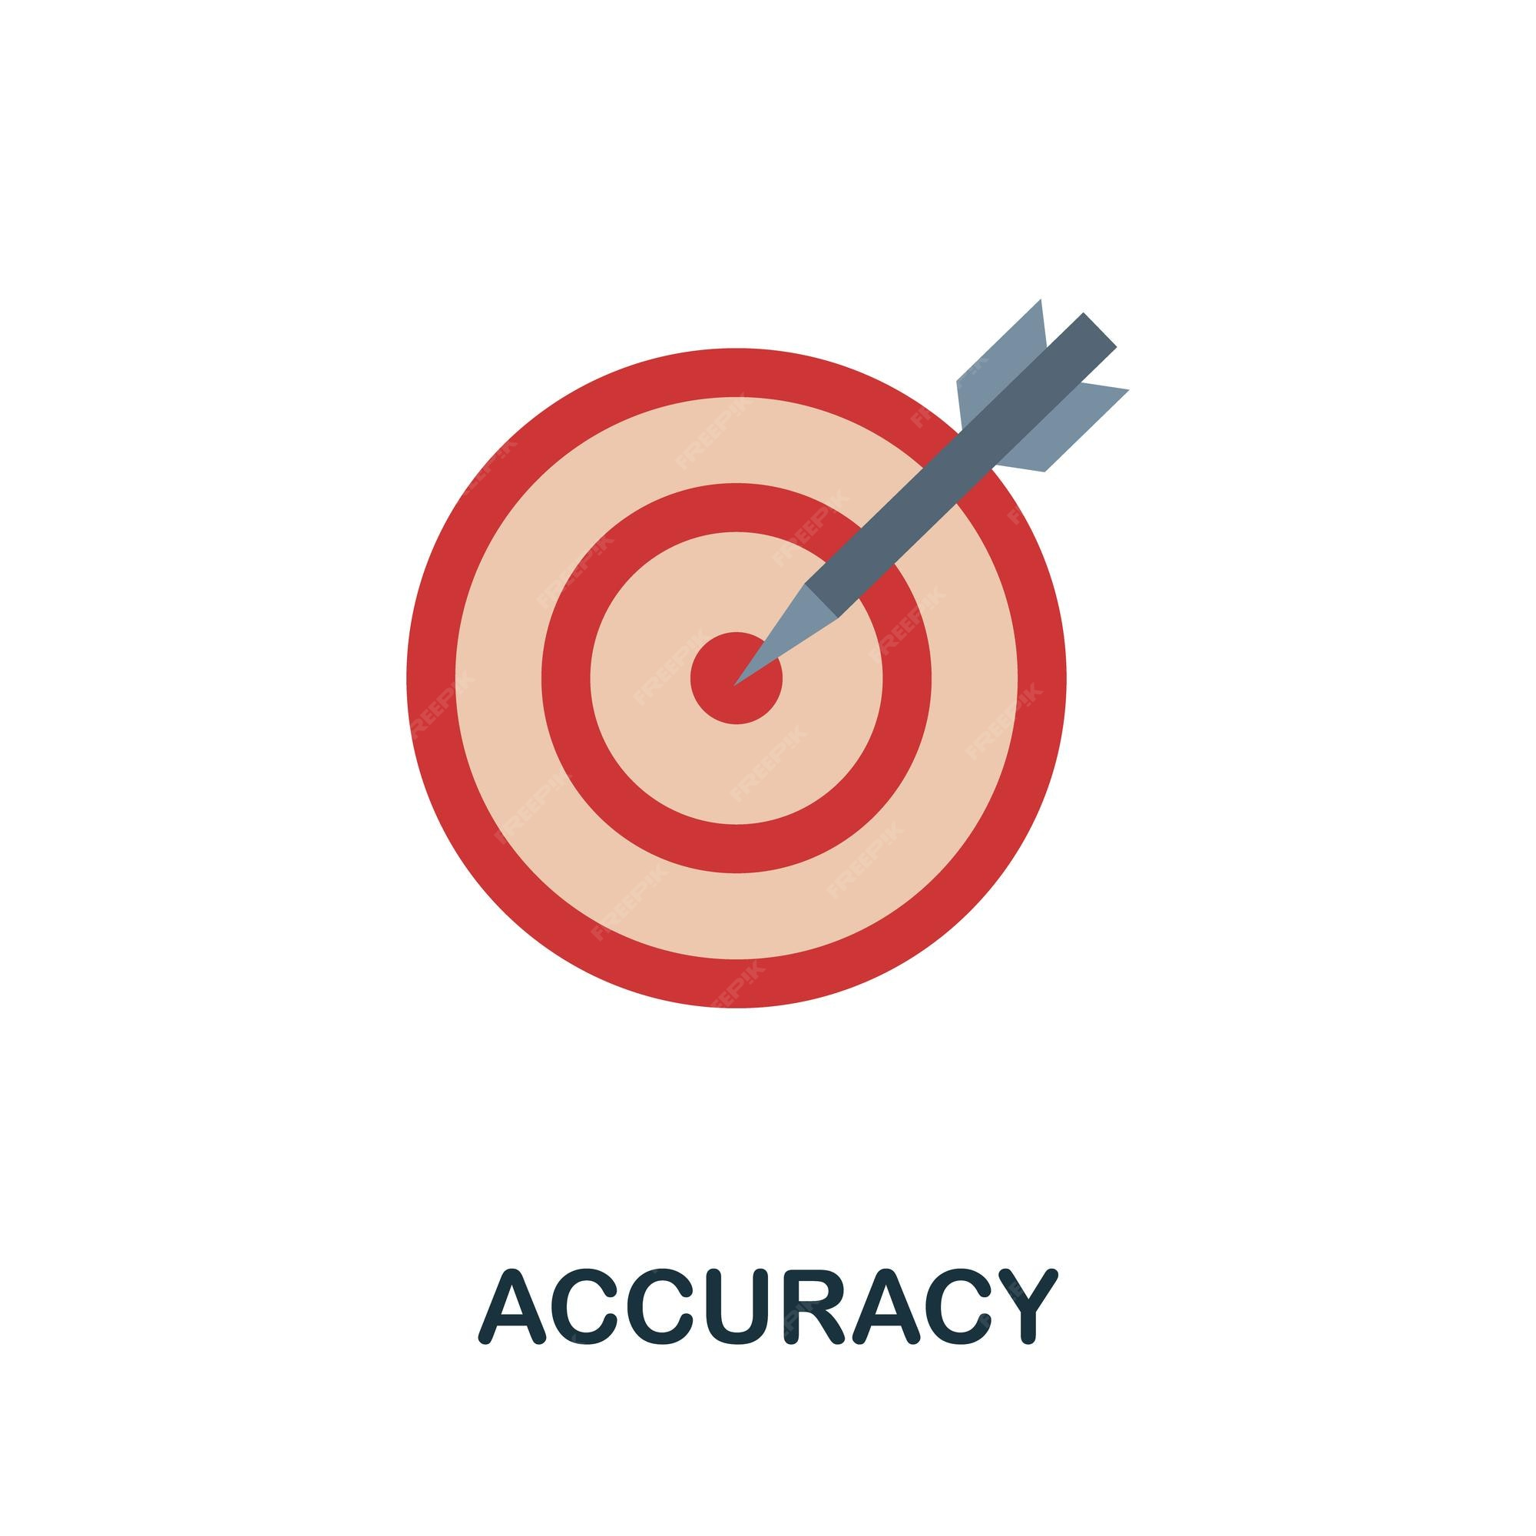
Contentify
Multilingual
Multimodal
Text

Slide 3
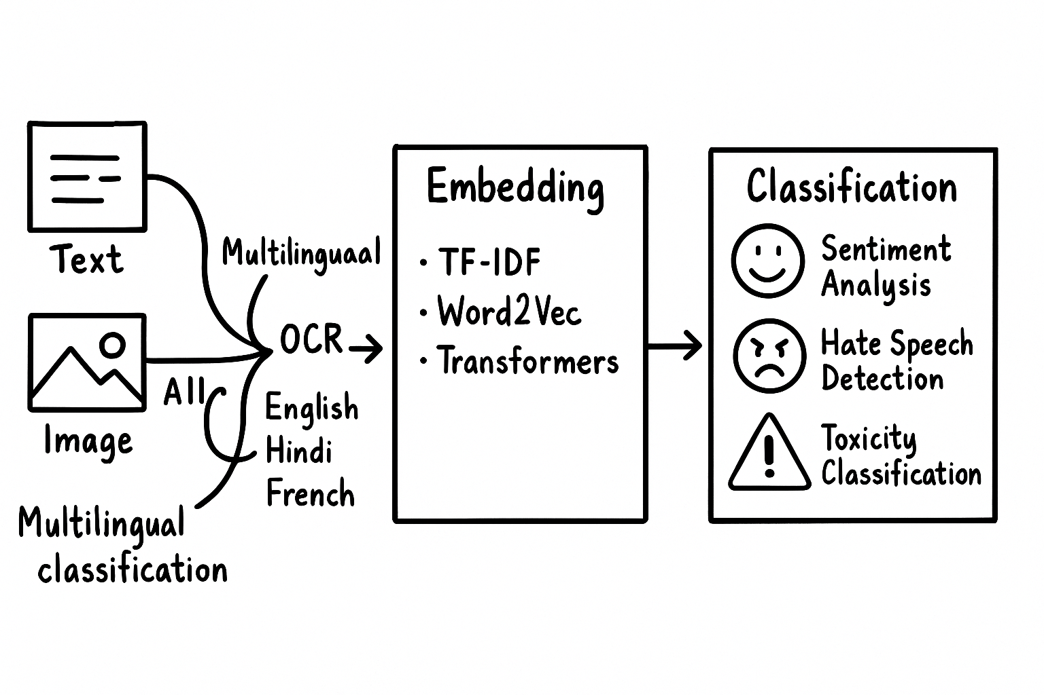




Slide 4
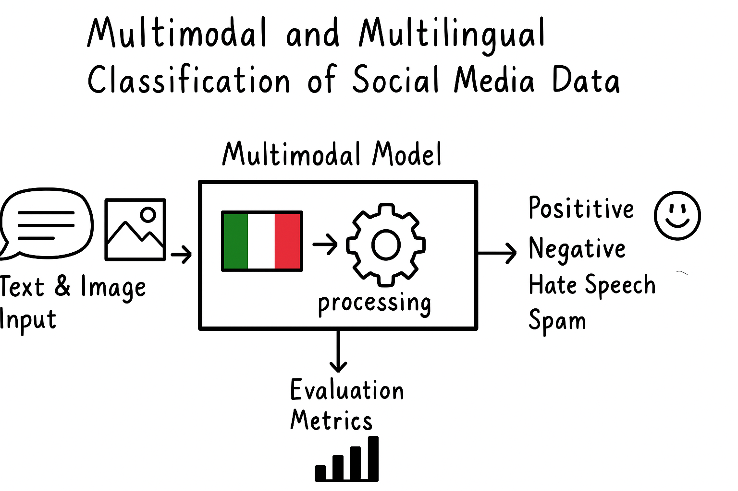

Slide 5
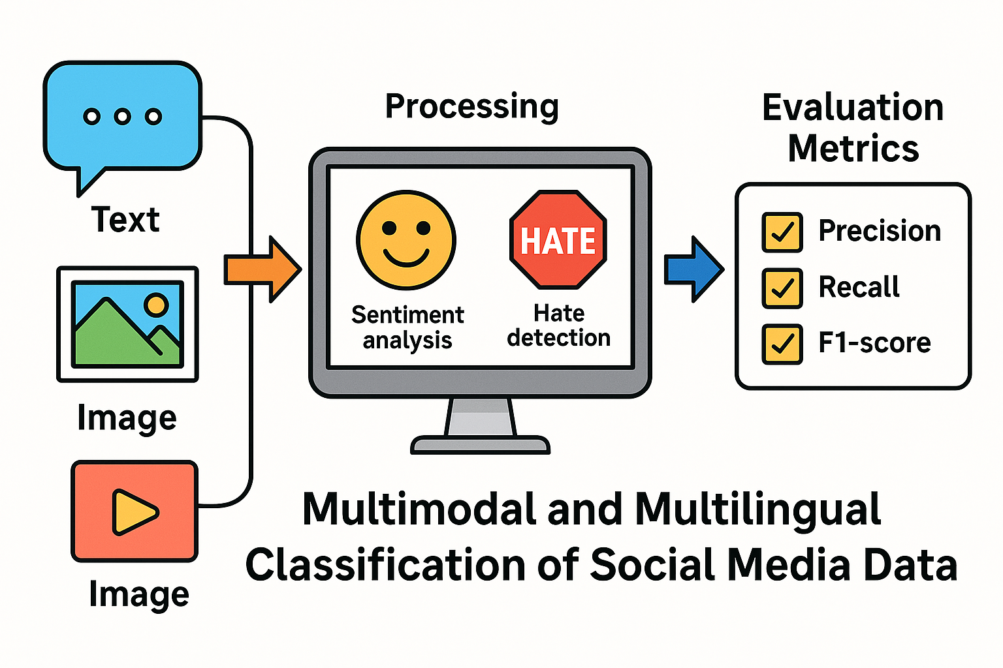

Slide 6
Abstract
The pervasive nature of communication in the digital age and social media have made these avenues the primary source of public discourse. Nonetheless, the lack of filtering or curation of this content raises serious challenges about recognizing abusive, prejudiced, or simply inappropriate messages in context. In this work, we propose a strong baseline system for the Multimodal and Multilingual Classification of Social Media Data, which input can be used both text and images.
Using the advanced natural language processing (NLP) and computer vision models, the suggested framework classifies the text content into a number of categories (e.g. sentiment: positive, negative, neutral; toxicity; hate speech; relevance). To enable use across environments, it is available in many languages. Word2Vec, TF-IDF, transformer-based models (e.g. BERT, RoBERTa, and XLM-R) process textual data, while deep learning models classifying the images out of OCR (Optical Character Recognition) process the image data for embedded data.

Slide 7
The proposed system will consist of several layers necessary for a learning-based system like preprocessing, feature extraction, classification and the final evaluation. These evaluation metrics include accuracy, precision, recall, and F1-score, which measure classification performance. Upcoming improvements involve semi-supervised learning, on-the-fly monitoring and large scale deployment to deal with variety of real world unlabeled datasets which will enhance our model.
By providing accurate detection and management of harmful, hateful, or emotional content across many languages and modalities, this project offers a scalable and intelligent solution for content moderation. By using advanced classification techniques, it promotes safer and more inclusive communities across social media platforms while ensuring responsible content moderation and creating healthier communication in the digital space.

Slide 8
In the present information age, a significant variety of social media platforms have been developed and become an integral part of modern life. Massive amounts of user generated data sourced form various social networking platforms also provide new insights for business and governments. However, it has become difficult to extract useful information from the vast amount of information effectively. Multimodal and multilingual sentimental analysis provides and an automated method of analyzing sentiment, emotion, degree of hate to address this issue. In this existing paper, a number of scholars have worked on improving the performance of the sentiment classifiers and applying them to various social media platforms.

